Slide 1

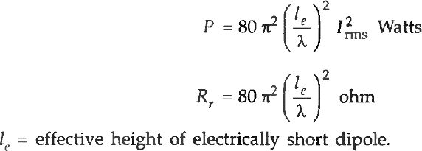
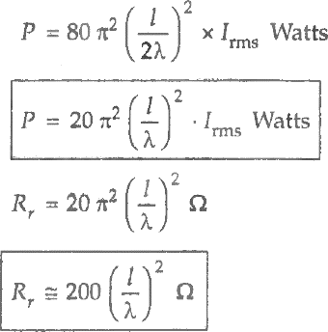
Antenna and Wave Propagation Electromagnetic Spectrum
Power Radiation and radiation resistance of linear antennas Electrically Short Dipole Antennas
The antennas which having length of dipoles up to quarter wave length (λ/4) and monopole of height up to one-eighth of wave length (λ/8) are called electrically short dipole antenna. However, the radiated power and radiation resistance are given as follows:
Monopole Antenna
For linear current distribution

Slide 2
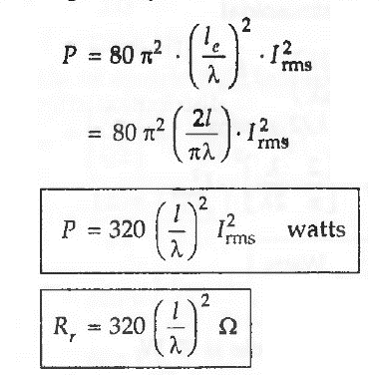
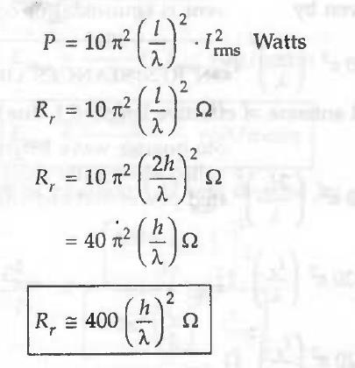
Antenna and Wave Propagation Electromagnetic Spectrum
For sinusoidal current distribution
Monopole Antenna
Power radiated and radiation resistance will be half of corresponding dipoles, i.e., for linear current distribution we gets:
For sinusoidal current distribution

Slide 3
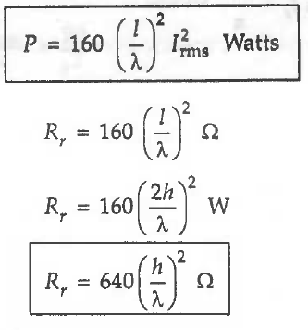

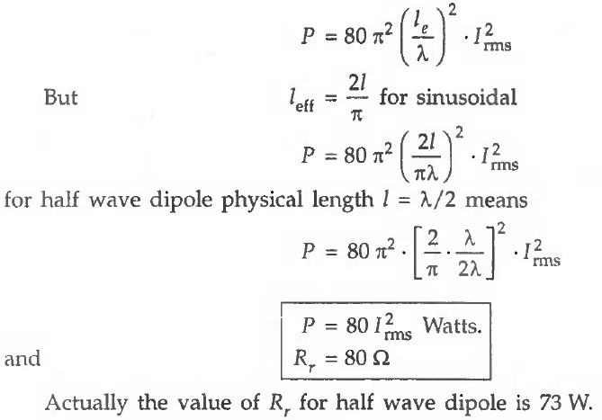

Antenna and Wave Propagation Electromagnetic Spectrum
Half – Wave Dipole Antenna
Vertically Earthed Antenna

Slide 4
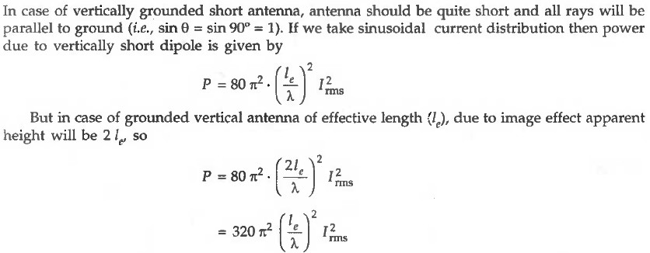

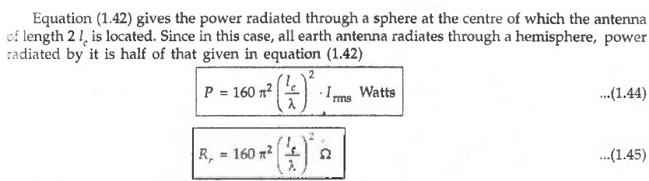
Antenna and Wave Propagation Electromagnetic Spectrum
For sinusoidal current distribution

Slide 5
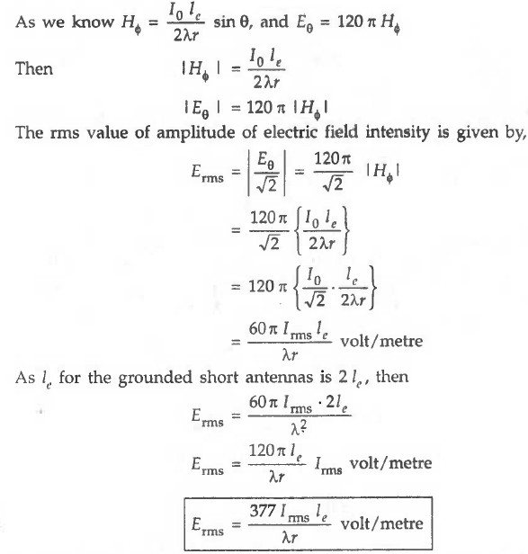

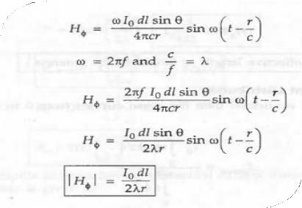
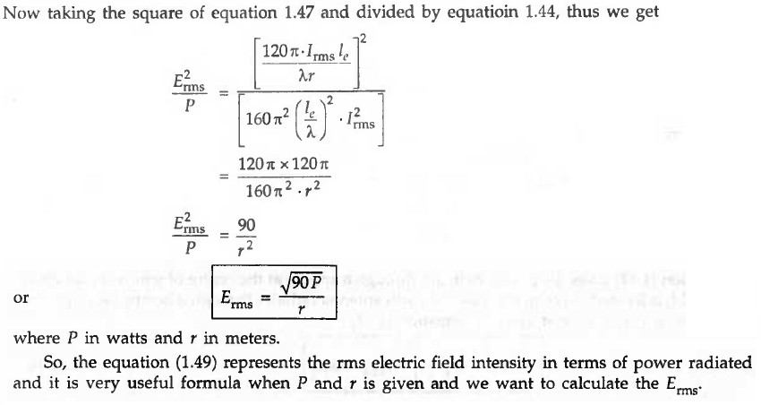
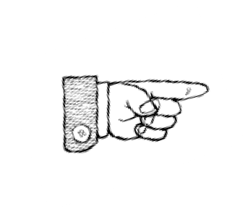
Antenna and Wave Propagation Electromagnetic Spectrum
R. M. S. Value of the Electric field Intensity at Distance r.

